Slide 1

2020 Regional Transportation Plan / Sustainable Communities Strategy for Butte County
Public Outreach Workshop
September 3, 2020 Chico, CA 4:00 p.m. – 6:00 p.m.
https://us02web.zoom.us/j/83753351998?pwd=MTkyS3JyM1JNQm84Yll4VjRGT3RKUT09&from=msft
Meeting ID: 837 5335 1998
Passcode: 693818
Dial by your location
+1 669 900 6833
Prepared by:
Ivan Garcia, Transportation Programming Specialist
Butte County Association of Governments
326 Huss Drive, Suite 150
Chico CA 95928
www.bcag.org 530-809-4616
igarcia@bcag.org

Slide 2
Workshop Procedures
Welcome and Introductions
Workshop Procedures:
What will be presented
How to participate and ask questions
How to submit questions later
Appropriate time to comment
How to Stay Involved
Where to Find More Information
BCAG Website: www.bcag.org
Project Manager: Ivan Garcia, igarcia@bcag.org

Slide 3
Purpose of Public Workshop
To inform the public of the Regional Transportation Plan (RTP) / Sustainable Communities Strategy (SCS) and the preliminary draft transportation project list and land use scenarios.
To provide the public an opportunity to engage in the planning process, provide input and learn about the project.
Focus of the Workshop is to:
  Discuss BCAG’s roles and responsibilities
  Discuss the purpose of the RTP
  Review preliminary draft transportation project list (short and long-term)
  Discuss the purpose of the SCS
  Review preliminary draft land use scenario
  Discuss update process and timeline
  Highways/Streets & Roads, Bike & Pedestrian, Transit, Rail, Aviation

Slide 4
What is BCAG?
Federal designated Metropolitan Planning Organization (MPO), state designated Regional Transportation Planning Agency (RTPA) for Butte County. BCAG is also the transit operator for Butte Regional Transit (B-Line)
BCAG Board of Directors – Includes all five County Supervisors one representative from each of the five incorporated cities/town
Responsibilities –
☑ Secure state and federal funding & ensure timely delivery
Prepare RTP/SCS and programming documents required to secure state and federal funding
☑ Ensure public participation in the planning process
☑ Butte Regional Transit Administrator
Planning or Project Management that benefit cities, town and county

Slide 5
Purpose of the Regional Transportation Plan
Meet state and federal requirements for other planning and funding activities
Serve as foundation for the development of :
☑ Federal Transportation Improvement Program
Regional Transportation Improvement Program
Interregional Transportation Improvement Program
The RTP/SCS has four main components:
Policy Element – Goals, policies & objectives
Action Element – Recommended projects by mode and fund source
Financial Element – Financial projections by fund source which project are constrained
Sustainable Communities Strategy – Integration of land use, housing, and transportation to reduce GHG’s

Slide 6
Camp Fire Impacts to Region
On November 8, 2018, the Camp Fire transformed the region by devastating the Town of Paradise which represented Butte County’s 2nd largest city (Town) with a pre-Camp Fire population of 26,256 in 2018 to a current population of 4,631 for January 1, 2020. As a result, BCAG is preparing a “Post Camp Fire Regional Population and Transportation Study”. The study will develop new:
Population forecasts
Housing forecasts
Employment forecasts
Travel / Transportation Data & Modeling
Transit and Non-Motorized Plan Update
The results of this effort will be available to local and regional agencies who are in need of data to update their local plans and programs. In addition, the data will be used as a foundation for the development of the 2024 RTP/SCS. This study is anticipated to be completed by June of 2021.

Slide 7
Regional Priorities – STIP
STIP - Project and Description | RIP Funds Only Year of Expenditure dollars in thousands
1. SR 70 Passing Lane Project – Segment 2. Termini @ south end of Segment 1. Project is 0.1 mile south of Palermo Rd to termini @ SR 70 Passing Lane Project (northern end) of SR70 E near Cox Lane. The scope of the project is to construct a 5-lane facility, 2 lanes per direction with center turn lane. Distance approx. 3.2 miles. Estimated cost is $53.4 million escalated. This project is funded with $36.9 million in Caltrans State Highway Operations and Protection Program (SHOPP) Funds, $6.6 million in Regional Improvement Program (RIP) funds, $6.6 million in Caltrans Interregional Improvement Program funds (IIP) and $3.3 million in federal Demonstration funds. This project is scheduled to be completed in the winter of 2021. | $ 6,600 (2020/21)
2. SR 70 Passing Lane Project – Segment 3. Termini @ south end of SR 70 Passing Lanes approximately 0.4-mile South of East Gridley Rd to the Butte/Yuba County line. Project includes new bridge structures. The scope is to construct 5 lane facility, 2 lanes per direction with center turn lane where appropriate. Distance is approximately 2.7 miles. Estimated cost is $65.9 million escalated to FY 21/22 dollars. This project is funded with $44.1 million in Caltrans State Highway Operations and Protection Program (SHOPP) Funds, $10.9 million in Regional Improvement Program (RIP) funds and $10.9 million in Caltrans Interregional Improvement Program funds (IIP). Project is anticipated to take 2 construction seasons to complete with a target in the winter of 2024. | $10,900 (2021/22) All Components
4. Planning Programming and Monitoring (PPM). This project consists of BCAG’s PPM activities related its transportation plans and programs. The annual average PPM programming level is estimated at $133,000 per year. This amount fluctuates with the STIP Fund Estimate. | $2,660 (2020-2040)
5. Regional Improvement Program (RIP) Reserve. Due to the project costs for the SR 70 Corridor and potential cost increases, no further regional projects are included at this time. In addition, due to the regional impacts associated with the Camp Fire and the development of the “Post Camp Fire Regional Population and Transportation Study”, a RIP fund reserve is being made for the 2020 RTP. Upon study completion and re-evaluation of regional transportation needs upon conclusion of the regional study, new RIP/STIP projects will be defined as part of the 2024 RTP/SCS. | $13,000 (2020-2040)
TOTAL | $33,160

Slide 8
Currently Funded Projects
Short-Term 2019 FTIP Projects
2019 FTIP Project Through August 2020
2018/19 - Year 1
AGENCY | Title | Local Funds | RIP-State | IIP-State | SHOPP | Demo | FTA Funds | CMAQ | HBP | HSIP | ATP | Totals
County | Monte Vista & Lower Wyandotte Class II Bike Project | 0 | 0 | 0 | 0 | 0 | 0 | 620 | 0 | 0 | 0 | 620
County | Autry Lane & Monte Vista Safe Routes to Schools Gap Closure Project | 25 | 0 | 0 | 0 | 0 | 0 | 0 | 0 | 0 | 0 | 25
County | Palermo/South Oroville SRTS Project, Phase 3 | 25 | 0 | 0 | 0 | 0 | 0 | 0 | 0 | 0 | 0 | 25
BCAG | FTA Sec. 5307 Program - B - Line | 2,325 | 0 | 0 | 0 | 0 | 2,039 | 0 | 0 | 0 | 0 | 4,364
BCAG | FTA Sec 5311 Program | 949 | 0 | 0 | 0 | 0 | 697 | 0 | 0 | 0 | 0 | 1,646
BCAG | FTA Section 5339 Program | 0 | 0 | 0 | 0 | 0 | 1,207 | 0 | 0 | 0 | 0 | 1,207
BCAG | FTA 5311f - Butte Regional Transt | 321 | 0 | 0 | 0 | 0 | 300 | 0 | 0 | 0 | 0 | 621
Caltrans | Grouped Projects for Safety Improvements - SHOPP Collision Reduction Program | 0 | 0 | 0 | 5,211 | 0 | 0 | 0 | 0 | 0 | 0 | 5,211
Caltrans | SR70 Passing Lanes (Segment 1) | 0 | 0 | 0 | 5,040 | 0 | 0 | 0 | 0 | 0 | 0 | 5,040
Caltrans | SR70 Passing Lanes (Segment 2) | 0 | 1,800 | 1,800 | 6,990 | 2,526 | 0 | 0 | 0 | 0 | 0 | 13,116
Caltrans | SR 70 Passing Lanes (Segment 3) | 0 | 0 | 0 | 0 | 0 | 0 | 0 | 0 | 0 | 0 | 0
Caltrans | Grouped Projects for Safety Improvements - SHOPP Mandates Program | 0 | 0 | 0 | 3,990 | 0 | 0 | 0 | 0 | 0 | 0 | 3,990
Caltrans | Grouped Projects for Shoulder Improvements - SHOPP Roadside Preservation Program | 0 | 0 | 0 | 1,841 | 0 | 0 | 0 | 0 | 0 | 0 | 1,841
Caltrans | SHOPP Minor Grouped Listing | 0 | 0 | 0 | 0 | 0 | 0 | 0 | 0 | 0 | 0 | 0
Caltrans | Grouped Projects for Pavement resurfacing and/or rehabilitation - SHOPP Roadway Preservation | 0 | 0 | 0 | 1,820 | 0 | 0 | 0 | 0 | 0 | 0 | 1,820
Chico | SR 99 Corridor Bikeway Phase 5 - 20th Street Crossing | 500 | 0 | 0 | 0 | 0 | 0 | 1,436 | 0 | 0 | 0 | 1,936
Chico | SR 99 Bikeway Phase 4 Improvements | 582 | 0 | 0 | 0 | 0 | 0 | 0 | 0 | 0 | 800 | 1,382
Chico | Bruce Rd Bridge Replacement Project | 500 | 0 | 0 | 0 | 0 | 0 | 0 | 0 | 0 | 0 | 500
Various | Grouped Projects for Bridge Rehabilitation and Reconstruction - HBP Program | 0 | 0 | 0 | 0 | 0 | 0 | 0 | 209 | 0 | 0 | 209
Various | Grouped Projects for Safety Improvements - HSIP Program | 1,772 | 0 | 0 | 0 | 0 | 0 | 0 | 0 | 5,220 | 0 | 6,992
Various | FTA 5310 Enhancement Program Group Listing - Non Infrastructure | 0 | 0 | 0 | 0 | 0 | 150 | 0 | 0 | 0 | 0 | 150
Totals |  | 6,999 | 1,800 | 1,800 | 24,892 | 2,526 | 4,393 | 2,056 | 209 | 5,220 | 800 | 50,694

Slide 9
Currently Funded Projects -Continued
2019/2020 - Year 2
AGENCY | Title | Local Funds | RIP-State | IIP-State | SHOPP | Demo | FTA Funds | CMAQ | HBP | HSIP | ATP | Totals
Biggs | Safe Routes to Schools Program | 1,340 | 0 | 0 | 0 | 0 | 0 | 0 | 0 | 0 | 0 | 1,340
Biggs | Biggs Safe Routes to School Project - Second Street | 0 | 0 | 0 | 0 | 0 | 0 | 150 | 0 | 0 | 0 | 150
County | Central House Rd Ovedr Wymann Ravine Bridge | 0 | 0 | 0 | 0 | 0 | 0 | 0 | 65 | 0 | 0 | 65
County | Autry Lane & Monte Vista Safe Routes to Schools Gap Closure Project | 25 | 0 | 0 | 0 | 0 | 0 | 0 | 0 | 0 | 0 | 25
County | Palermo/South Oroville SRTS Project, Phase 3 | 0 | 0 | 0 | 0 | 0 | 0 | 350 | 0 | 0 | 0 | 350
BCAG | FTA Sec. 5307 Program - B - Line | 2,325 | 0 | 0 | 0 | 0 | 2,325 | 0 | 0 | 0 | 0 | 4,649
BCAG | FTA Sec 5311 Program | 949 | 0 | 0 | 0 | 0 | 697 | 0 | 0 | 0 | 0 | 1,646
BCAG | FTA Section 5339 Program | 0 | 0 | 0 | 0 | 0 | 1,207 | 0 | 0 | 0 | 0 | 1,207
BCAG | FTA 5311f - Butte Regional Transt | 321 | 0 | 0 | 0 | 0 | 300 | 0 | 0 | 0 | 0 | 621
Caltrans | Grouped Projects for Safety Improvements - SHOPP Collision Reduction Program | 0 | 0 | 0 | 23,519 | 0 | 0 | 0 | 0 | 0 | 0 | 23,519
Caltrans | SR70 Passing Lanes (Segment 1) | 0 | 3,700 | 3,700 | 26,830 | 0 | 0 | 0 | 0 | 0 | 0 | 34,230
Caltrans | SR 70 Passing Lanes (Segment 3) | 0 | 2,300 | 2,300 | 8,718 | 0 | 0 | 0 | 0 | 0 | 0 | 13,318
Caltrans | Grouped Projects for Bridge Rehabilitation and Reconstruction - SHOPP Bridge Program | 0 | 0 | 0 | 20,306 | 0 | 0 | 0 | 0 | 0 | 0 | 20,306
Caltrans | Grouped Projects for Safety Improvements - SHOPP Mobility Program | 0 | 0 | 0 | 1,218 | 0 | 0 | 0 | 0 | 0 | 0 | 1,218
Caltrans | Grouped Projects for Emergency Repair - SHOPP Emergency Response Program | 0 | 0 | 0 | 30,732 | 0 | 0 | 0 | 0 | 0 | 0 | 30,732
Caltrans | Grouped Projects for Pavement resurfacing and/or rehabilitation - SHOPP Roadway Preservation | 0 | 0 | 0 | 3,665 | 0 | 0 | 0 | 0 | 0 | 0 | 3,665
Chico | Esplanade Corridor Safety and Accessibility Improvement Project | 70 | 0 | 0 | 0 | 0 | 0 | 0 | 0 | 0 | 1,005 | 1,075
Gridley | Central Gridley Pedestrian Connectivity and Equal Access Project | 1,335 | 0 | 0 | 0 | 0 | 0 | 160 | 0 | 0 | 0 | 1,495
Gridley | Gridley Bike & Pedestrian SR 99 Corridor Facility Project | 0 | 0 | 0 | 0 | 0 | 0 | 160 | 0 | 0 | 0 | 160
Paradise | Pentz Road Trailway Phase II | 0 | 0 | 0 | 0 | 0 | 0 | 700 | 0 | 0 | 0 | 700
Paradise | Paradise ATP Gateway Project | 0 | 0 | 0 | 0 | 0 | 0 | 550 | 0 | 0 | 0 | 550
Various | Grouped Projects for Bridge Rehabilitation and Reconstruction - HBP Program | 10,584 | 0 | 0 | 0 | 0 | 0 | 0 | 14,062 | 0 | 0 | 24,646
Various | FTA 5310 Enhancement Program Group Listing - Non Infrastructure | 0 | 0 | 0 | 0 | 0 | 609 | 0 | 0 | 0 | 0 | 609
Totals |  | 16,949 | 6,000 | 6,000 | 114,988 | 0 | 5,138 | 2,070 | 14,127 | 0 | 1,005 | 166,276

Slide 10
Currently Funded Projects - Continued
2020/21 Year 3
AGENCY | Title | Local Funds | RIP-State | IIP-State | SHOPP | Demo | FTA Funds | CMAQ | HBP | HSIP | ATP | Totals
County | Autry Lane & Monte Vista Safe Routes to Schools Gap Closure Project | 2,600 | 0 | 0 | 0 | 0 | 0 | 200 | 0 | 0 | 0 | 2,800
County | Palermo/South Oroville SRTS Project, Phase 3 | 150 | 0 | 0 | 0 | 0 | 0 | 150 | 0 | 0 | 0 | 300
BCAG | Planning, Programming and Monitoring | 0 | 133 | 0 | 0 | 0 | 0 | 0 | 0 | 0 | 0 | 133
BCAG | FTA Sec. 5307 Program - B - Line | 2,325 | 0 | 0 | 0 | 0 | 2,325 | 0 | 0 | 0 | 0 | 4,649
BCAG | FTA Sec 5311 Program | 949 | 0 | 0 | 0 | 0 | 697 | 0 | 0 | 0 | 0 | 1,646
BCAG | FTA Section 5339 Program | 0 | 0 | 0 | 0 | 0 | 1,207 | 0 | 0 | 0 | 0 | 1,207
BCAG | FTA 5311f - Butte Regional Transt | 321 | 0 | 0 | 0 | 0 | 300 | 0 | 0 | 0 | 0 | 621
Caltrans | Grouped Projects for Safety Improvements - SHOPP Collision Reduction Program | 0 | 0 | 0 | 2,350 | 0 | 0 | 0 | 0 | 0 | 0 | 2,350
Caltrans | SR70 Passing Lanes (Segment 2) | 0 | 4,800 | 4,800 | 28,890 | 0 | 0 | 0 | 0 | 0 | 0 | 38,490
Caltrans | Grouped Projects for Safety Improvements - SHOPP Mobility Program | 0 | 0 | 0 | 9,857 | 0 | 0 | 0 | 0 | 0 | 0 | 9,857
Caltrans | Grouped Projects for Emergency Repair - SHOPP Emergency Response Program | 0 | 0 | 0 | 57,546 | 0 | 0 | 0 | 0 | 0 | 0 | 57,546
Caltrans | SHOPP Minor Grouped Listing | 0 | 0 | 0 | 0 | 0 | 0 | 0 | 0 | 0 | 1,455 | 1,455
Caltrans | Grouped Projects for Pavement resurfacing and/or rehabilitation - SHOPP Roadway Preservation | 0 | 0 | 0 | 2,650 | 0 | 0 | 0 | 0 | 0 | 0 | 2,650
Chico | Esplanade Corridor Safety and Accessibility Improvement Project | 0 | 0 | 0 | 0 | 0 | 0 | 0 | 0 | 0 | 6,235 | 6,235
Oroville | SR 162 Pedestrian/Bicycle Disabled Mobility and Safety Improvements Project | 0 | 0 | 0 | 0 | 0 | 0 | 540 | 0 | 0 | 3,411 | 3,951
Paradise | Oliver Curve Class I Phase I | 4,625 | 0 | 0 | 0 | 0 | 0 | 350 | 0 | 0 | 0 | 4,975
Various | Grouped Projects for Safety Improvements - HSIP Program | 0 | 0 | 0 | 0 | 0 | 0 | 0 | 0 | 2,242 | 0 | 2,242
Various | FTA 5310 Enhancement Program Group Listing - Non Infrastructure | 0 | 0 | 0 | 0 | 0 | 150 | 0 | 0 | 0 | 0 | 150
Totals |  | 10,970 | 4,933 | 4,800 | 101,293 | 0 | 4,678 | 1,240 | 0 | 2,242 | 11,101 | 141,257

Slide 11
Currently Funded Projects - Continued
2021/22 - Year 4
AGENCY | Title | Local Funds | RIP-State | IIP-State | SHOPP | Demo | FTA Funds | CMAQ | HBP | HSIP | ATP | Totals
County | Central House Rd Ovedr Wymann Ravine Bridge | 3,325 | 0 | 0 | 0 | 0 | 0 | 0 | 0 | 0 | 0 | 3,325
County | Palermo/South Oroville SRTS Project, Phase 3 | 1,675 | 0 | 0 | 0 | 0 | 0 | 0 | 0 | 0 | 0 | 1,675
BCAG | Planning, Programming and Monitoring | 0 | 133 | 0 | 0 | 0 | 0 | 0 | 0 | 0 | 0 | 133
BCAG | FTA Sec. 5307 Program - B - Line | 2,325 | 0 | 0 | 0 | 0 | 2,325 | 0 | 0 | 0 | 0 | 4,649
BCAG | FTA Sec 5311 Program | 949 | 0 | 0 | 0 | 0 | 697 | 0 | 0 | 0 | 0 | 1,646
BCAG | FTA Section 5339 Program | 0 | 0 | 0 | 0 | 0 | 1,207 | 0 | 0 | 0 | 0 | 1,207
BCAG | FTA 5311f - Butte Regional Transt | 321 | 0 | 0 | 0 | 0 | 300 | 0 | 0 | 0 | 0 | 621
Caltrans | Grouped Projects for Safety Improvements - SHOPP Collision Reduction Program | 0 | 0 | 0 | 18,300 | 0 | 0 | 0 | 0 | 0 | 0 | 18,300
Caltrans | SR 70 Passing Lanes (Segment 3) | 0 | 8,600 | 8,600 | 31,950 | 0 | 0 | 0 | 0 | 0 | 0 | 49,150
Caltrans | Grouped Projects for Emergency Repair - SHOPP Emergency Response Program | 0 | 0 | 0 | 33,560 | 0 | 0 | 0 | 0 | 0 | 0 | 33,560
Caltrans | Grouped Projects for Pavement resurfacing and/or rehabilitation - SHOPP Roadway Preservation | 0 | 0 | 0 | 4,690 | 0 | 0 | 0 | 0 | 0 | 0 | 4,690
Chico | Guynn Rd over Lindo Channel Bridge Project | 0 | 0 | 0 | 0 | 0 | 0 | 0 | 150 | 0 | 0 | 150
Gridley | Gridley Bike & Pedestrian SR 99 Corridor Facility Project | 200 | 0 | 0 | 0 | 0 | 0 | 0 | 0 | 0 | 0 | 200
Paradise | Pentz Road Trailway Phase II | 9,270 | 0 | 0 | 0 | 0 | 0 | 0 | 0 | 0 | 0 | 9,270
Paradise | Paradise ATP Gateway Project | 7,975 | 0 | 0 | 0 | 0 | 0 | 0 | 0 | 0 | 0 | 7,975
Various | Grouped Projects for Bridge Rehabilitation and Reconstruction - HBP Program | -2,757 | 0 | 0 | 0 | 0 | 0 | 0 | 3,460 | 0 | 0 | 702
Various | Grouped Projects for Safety Improvements - HSIP Program | 283 | 0 | 0 | 0 | 0 | 0 | 0 | 0 | 1,714 | 0 | 1,997
Various | FTA 5310 Enhancement Program Group Listing - Non Infrastructure | 0 | 0 | 0 | 0 | 0 | 150 | 0 | 0 | 0 | 0 | 150
Totals |  | 23,566 | 8,733 | 8,600 | 88,500 | 0 | 4,678 | 0 | 3,610 | 1,714 | 0 | 139,400

Slide 12
FTIP Summary – 4 Year Period
 |  | Dollars x 1,000
2019 FTIP - 4 Year Only Period |  | Local Funds | RIP-State | IIP-State | SHOPP | Demo | FTA Funds | CMAQ | HBP | HSIP | ATP | Totals
 |  | 58,482 | 21,466 | 21,200 | 329,673 | 2,526 | 18,886 | 5,366 | 17,946 | 9,176 | 12,906 | 497,627

Slide 13

BCAG operates Butte Regional Transit (B-Line) for fixed route and paratransit service. The purpose of Transit in the RTP is to identify the existing route structure and to identify planned improvements.
The public is encouraged to voice their thoughts and opinions on what transit or other mass transportation improvements BCAG should be working on in the future.
In 2015, BCAG completed a Transit and Non-Motorized Plan to help guide the transit decision making process. Extensive public outreach was conducted to help plan the current transit system. The plan is posted online at: http://www.bcag.org/Planning/Transit--Non-Motorized-Transportation-Plan/index.html. The existing routes are later displayed. The current transit projects are based on this plan.

Slide 14
Transit - Continued
CHICO
There are 12 local routes that operate in the Chico Urban Area. All these
routes, with the exception of Route 7 (which covers the east side of Chico),
serve the Downtown Chico Transit Center at 2nd and Salem streets. All these
routes provide at least hourly service throughout the day, with most adding
half-hour service during peak times. Three of them (8, 9 & 15) run half-hour
headways all day, with Route 15 providing 20-minute headways during peak
periods. All the routes operate year-round, except Routes 8 & 9, which are
designated as the Student Shuttles and only running when Chico State is
in session.
In addition to the local Chico routes, there are four regional routes that also
stage at the Chico Transit Center. These include Route 20 (Oroville), Route 32
(Gridley), and Routes 40 & 41 (Paradise & Magalia).
OROVILLE
Four local routes (24, 25, 26 & 27) provide hourly service to the Oroville area.
These local routes operate Monday-Friday. In addition, two regional routes -
Route 20 (Chico) and Route 30 (Gridley) also serve the Oroville Transit Center.
Oroville had one additional route (Route 31 from Paradise), but that was
discontinued after the Camp Fire.

Slide 15
Transit - Continued
PARADISE
The Paradise/Magalia Area is served by two routes - 40 & 41.
These are regional routes from Chico that also provide local
service to the ridge. After the Camp Fire bus service in the Paradise area was greatly affected. One route (31) was eliminated and the overall service hours were reduced by 44%.
GRIDLEY/BIGGS
Two regional routes, 30 (Oroville) & 32 (Chico) provide service Gridley/Biggs and act as the local service for this area.
ADDITIONAL HIGHLIGHTS
Over 500 bus stops systemwide, with 150 having shelters
Schedules at all stops, with some having Real-Time signage
AVL/GPS installed on entire fleet, which allows passengers to
access Real-Time bus arrival information. Also allows for
tracking of boarding location to make route improvements
Mobile Ticketing app being rolled out
?????

Slide 16
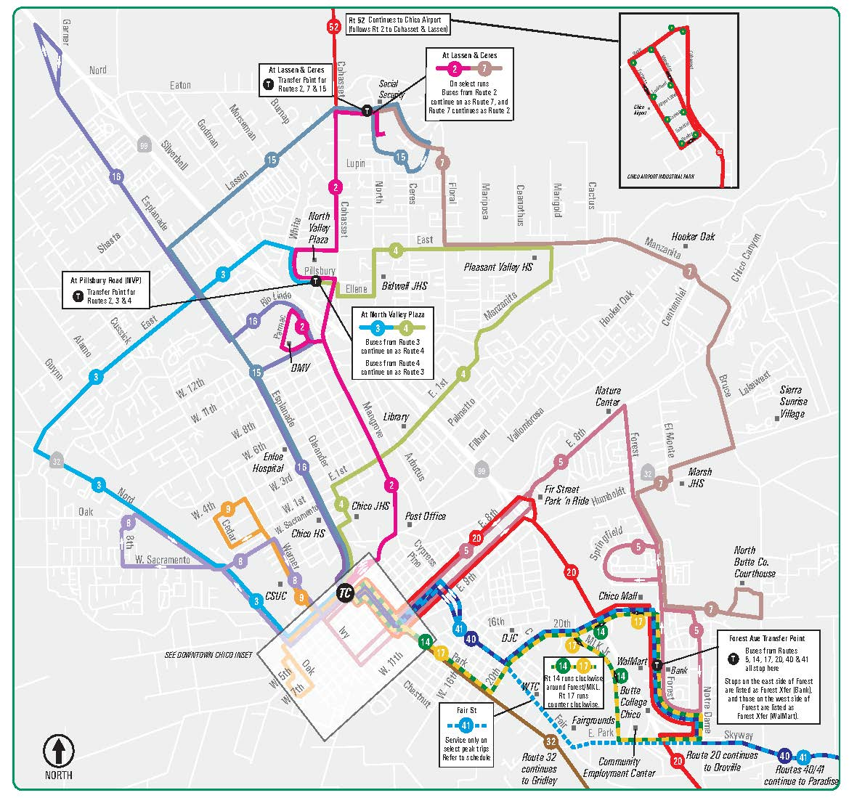
Transit – Chico Routes

Slide 17
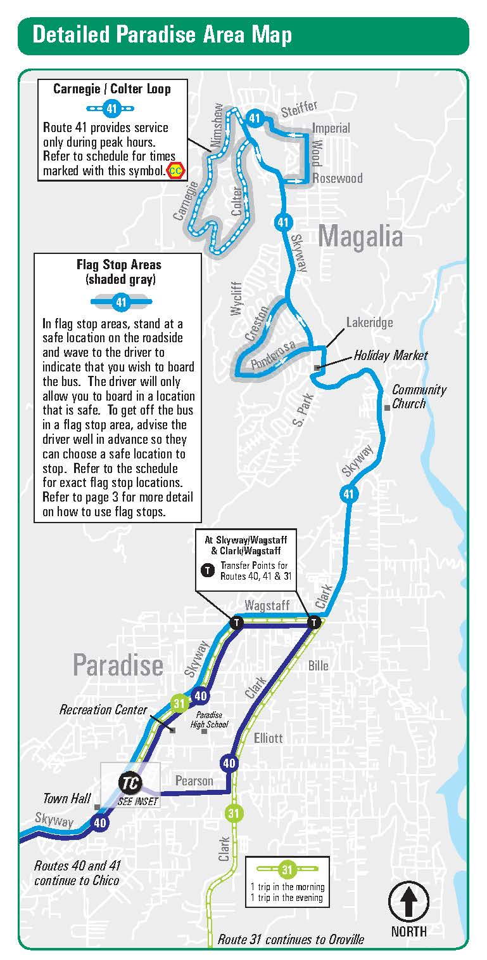
Transit – Paradise/Magalia Routes

Slide 18
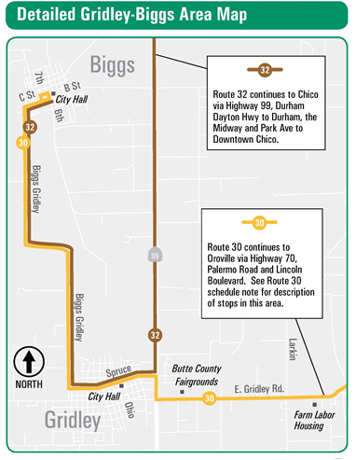
Transit –Gridley/Biggs

Slide 19
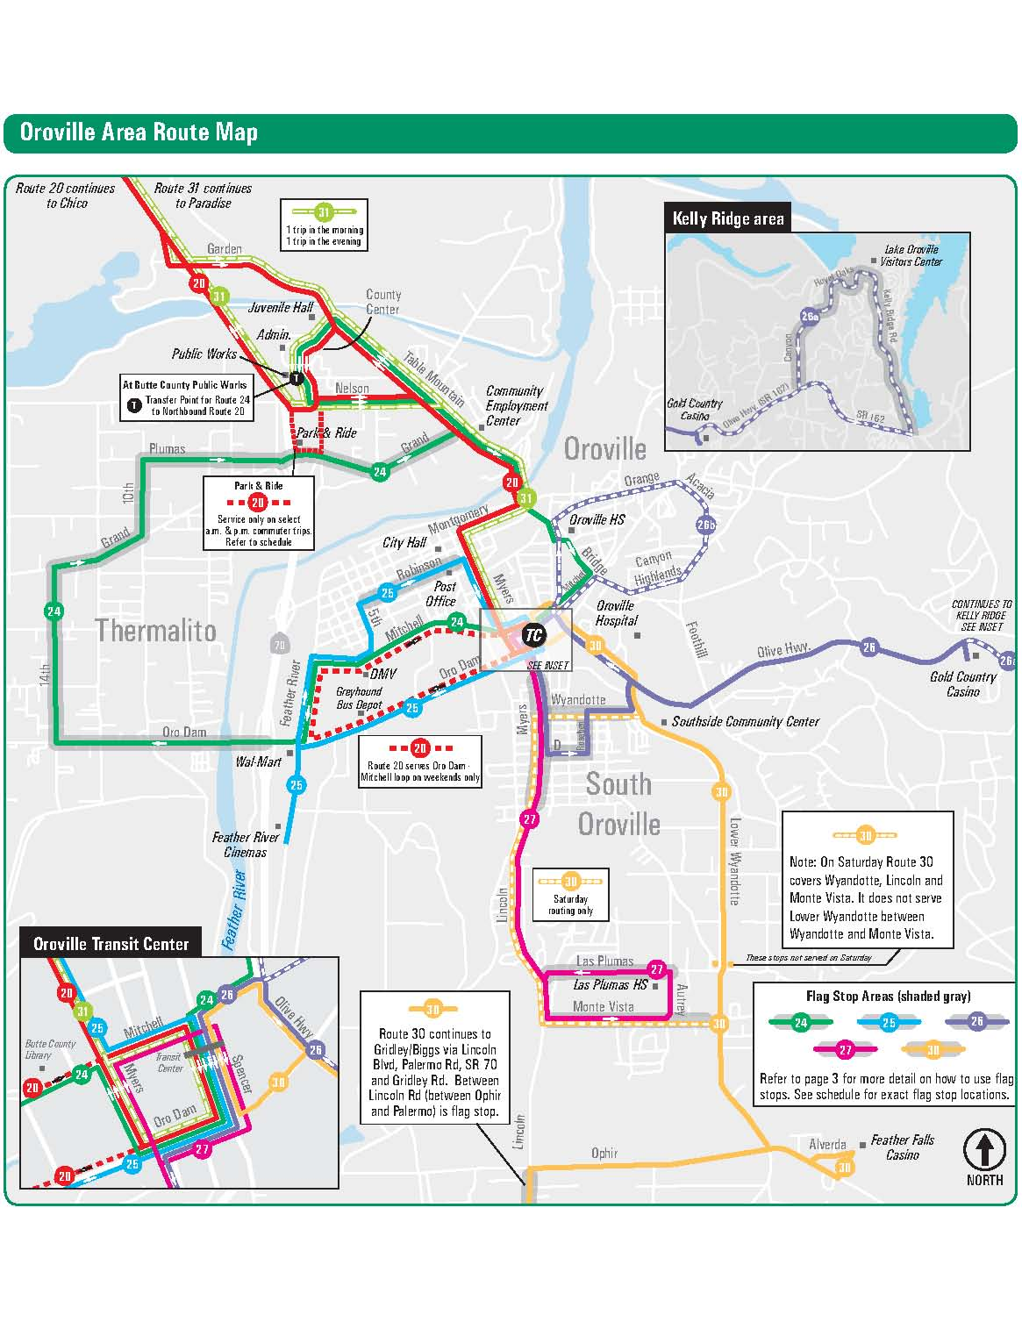
Transit – Oroville Routes

Slide 20
Non-Motorized Transportation
BCAG works with each of the local jurisdictions to coordinate bicycle route improvements for the region and assists in developing grant applications for state and federal grant opportunities.
The following maps are from the City of Chico and Butte County’s Bicycle Plan.
What routes or projects should BCAG or the local jurisdictions be considering for the future?

Slide 21
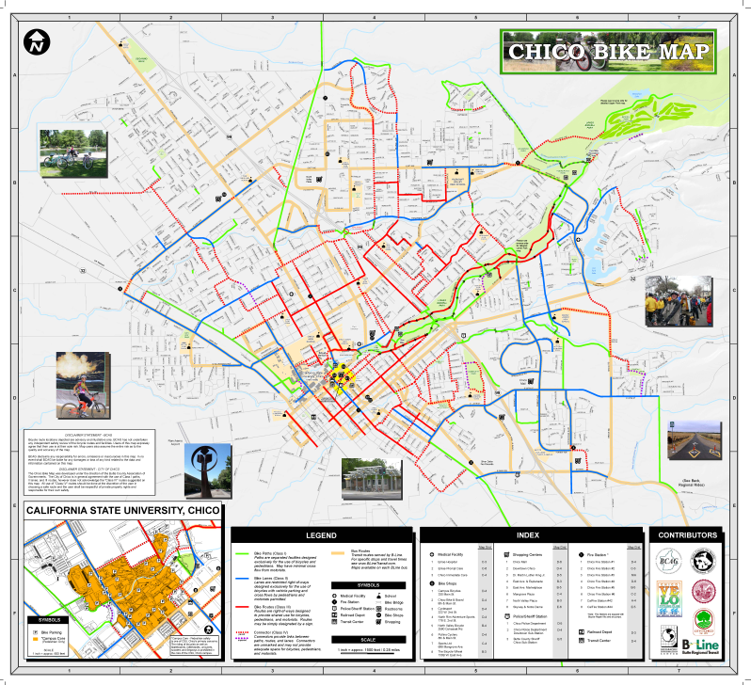
Non-Motorized Transportation
(Bicycle)

Slide 22
Financial Element
The following are BCAG financial sources for projects in the RTP /SCS. Forecasts are developed for each fund source identified below. The RTP/SCS is required to be financially constrained.
Butte Regional Transit:
FTA Section 5307 FTA Section 5310
FTA Section 5311 FTA Section 5339
FTA Section 5311(f) FTA Section 5304
LCTOP SB-1 Planning
TDA CMAQ
Highways, Local Streets and Roads and Active Transportation:
Regional Improvement Program (RIP)
Interregional Improvement Program (IIP)
State Highway Operations and Protection Program (SHOPP)
Congestion Mitigation and Air Quality (CMAQ)
Regional Surface Transportation Program (RSTP)
Highway Improvement Program (HIP)
Highway Bridge Program (HBP)
Highway Safety Improvement Program (HSIP)

Slide 23
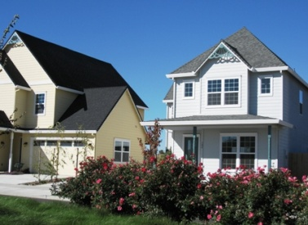
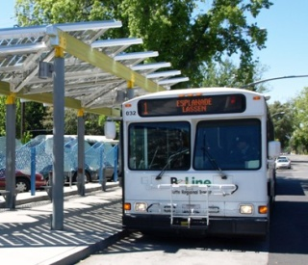
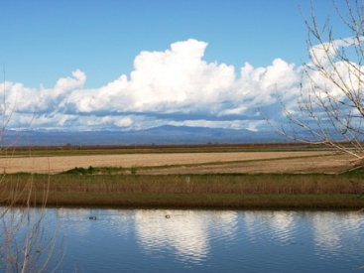
Sustainable Communities Strategy (SCS)- What is it?
An element first included in the 2012 RTP with the passage of Senate Bill 375 (Steinberg) – Sustainable Communities and Climate Protection Act of 2008
Demonstrates the integration of land use, housing, and transportation to reduce passenger vehicle (cars & light trucks) greenhouse gas emissions (GHG)
Goal to meet GHG emission reduction targets set by the California Air Resources Board (CARB) for the years 2020 and 2035

Slide 24
SCS – Goals
Reduce Greenhouse Gas Emissions – The primary objective of the SCS is to meet GHG reduction targets established by the state, by reducing passenger vehicle travel.
Manage Region’s Growth – Projections show that over the next 22 years, the region’s population will increase by ~38,000 people, an estimated 16,000 new homes will be needed, in addition to 11,000 rebuild homes from the Camp Fire, to accommodate this growth.
Provide Opportunities for Affordable Housing – The SCS must be consistent with the Regional Housing Needs Plan, assuring that each community provides for a mix of housing affordable to all economic segments of the population.
Preserve Farmland and Natural Resources – SCS must consider the region’s natural resources and prime farmlands.

Slide 25
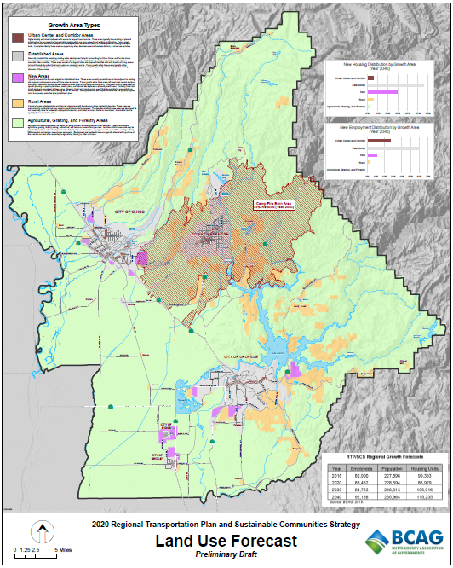
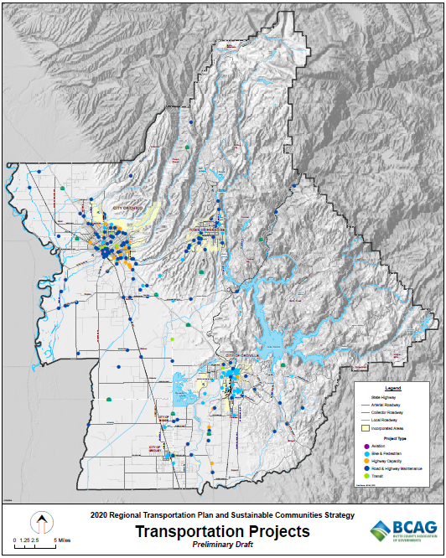
SCS – Components
Land Use Allocation - must identify the general location of different land use types, residential densities, and areas to house the region’s forecasted growth
Transportation Network - financially constrained multimodal network which serves the transportation needs of the region

Slide 26
SCS – Strategies
Land Use
Increase mixed use development and development in areas with existing infrastructure
Increase residential/commercial density near transit
Provide local housing for local workforce to improve the jobs – housing balance
Transportation
Improve and expand transit
Improve and expand pedestrian and bicycle facilities and infrastructure
Improve linkages between modes of travel (auto, transit, bike, and walk)
Minimize the addition of general-purpose road lanes
Maintain the existing road network

Slide 27
2012 SCS
First BCAG RTP to include SCS under SB375
Land Use Focused – brought together several planning efforts
  New local jurisdiction general plans
  Regional habitat conservation plan
  Regional blueprint efforts
  Incorporated Regional Housing Needs Plan
2016 SCS
Integrated the new Butte Long-Range Transit & Non-Motorized Plan
Overall population and housing growth declined based on state forecasts
Adjusted preferred “balanced” land use scenario based on new forecasts and development activity

Slide 28
2020 SCS
Incorporate recommendations from BCAG’s 2018 SCS Progress Report.
  Revise forecasted jobs, population, and housing
  Adjust housing mix and jobs-housing ratio to align with recent trends
  Review transportation investments based on new funding sources and current FTIP programming
  Continue implementation of Long-Range Transit and Non-Motorized Plan
    Remain on track with new bike/ped infrastructure
    Increase frequency, expand and optimize existing service
  Continue to monitor development within Butte Regional Conservation Plan (BRCP) – Urban Permit Areas
Account for known impacts of Camp Fire and incorporate reasonable assumptions moving forward.
Increase ability to model transit/bike/ped improvements of plan

Slide 29

2020 RTP/SCS Preliminary Draft Land Use Scenario
Land Use
Slower growth rate than past plans (>50% decrease), per CA Department of Finance Forecasts
Continues development pattern included in past RTP/SCS with adjusted housing-mix and jobs-housing ratios
Assumes ~75-85% rebuild of homes and businesses lost in Camp Fire, within burn area

Slide 30
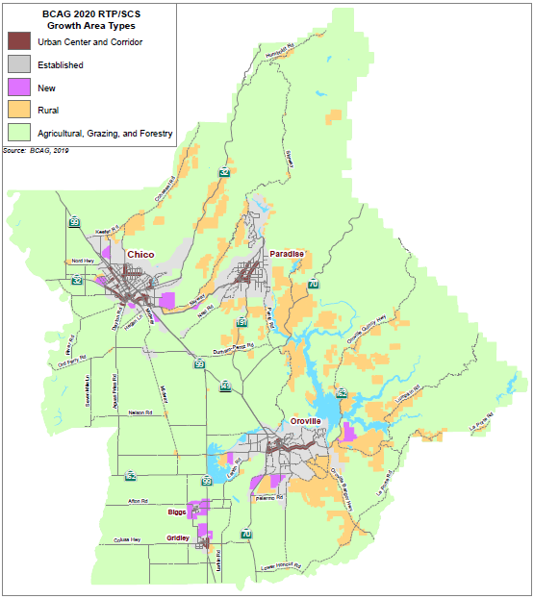
Land Use Allocation

Slide 31
Land Use cont.
Increase long-term ratio from 0.78 (2016 RTP/SCS) to 0.80 (2020 RTP/SCS)

Slide 32
2020 RTP/SCS Preliminary Draft Transportation Scenario
Transportation
No additional freeway general-purpose lanes from past RTPs
Implement long-range transit plan from 2016 RTP (currently updating with Post Camp Fire Study)
Increased bike and pedestrian infrastructure
GHG Reductions
Meets regional targets (Approx. -15% for year 2020 and -10% for year 2035)

Slide 33
Local Government Coordination
Local governments are directly involved in the development of the 2020 RTP/SCS.
Planning Directors Working Group
Consists of planning professionals from local jurisdictions and the Butte LAFCO
Provides direction and input regarding the land use allocation component of the RTP/SCS
Transportation Advisory Committee
Established BCAG committee which provides input into the overall RTP
Provides input into the transportation network component of the RTP/SCS

Slide 34
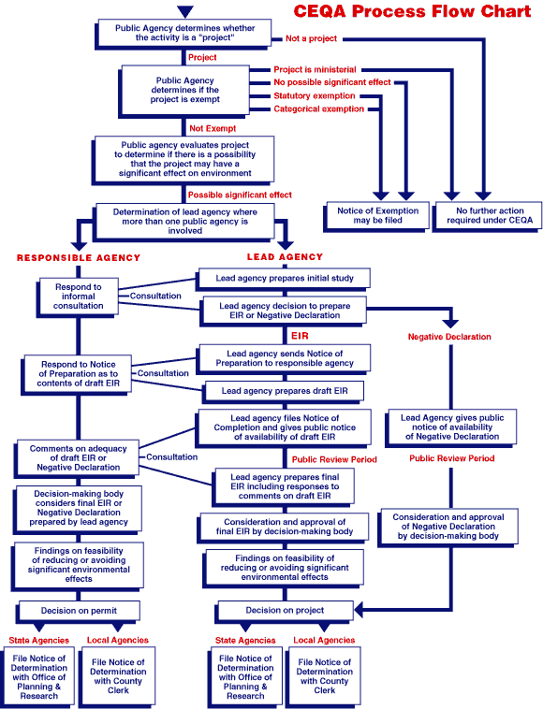
CEQA Benefits
Development projects which are consistent with the RTP/SCS may be eligible for CEQA streamlining.
Types of projects which may be eligible:
Mixed-Use Residential Projects (has at least 75% of the building square footage in residential)
Transit Priority Project (residential projects located near major transit stops which meet density and use requirements described in SB 375.)
Sustainable Communities Projects (meets transit priority projects + additional)

Slide 35
Public Involvement
Many opportunities are provided for public input into the 2020 RTP/SCS.
Public Workshops – four rounds of workshops taking place throughout the region (August 2018, November 2019, September 2020, and October/November 2020.
Public Hearings – conducted at regularly scheduled meetings of the BCAG Board of Directors
Public Comment and Review Periods – noticed in the local newspapers and BCAG website
Website and Email Notification List – ask to be placed on the RTP/SCS notification list and receive information regarding activities related to the SCS.
Email RTPComments@bcag.org

Slide 36
RTP/SCS Process Timeline
First Round Public Workshops (August 2018)
RTP/SCS Development - Preliminary Financial and Policy Elements (January – June 2019)
Second Round Public Workshops (November 2019)
Prepare Preliminary Transportation Project List and Land Use Scenarios (June 2019 – July 2020)
Third Round Public Workshop (September 2020)
Draft RTP/SCS, Environmental Impact Report, and Air Quality Analysis (September 2020)
Fourth Round Public Workshops (October/November 2020)
Final RTP/SCS to BCAG Board for Adoption (December 2020)

Slide 37
Next Steps
Preliminary Draft Transportation Project List and Land Use Scenario
  Public Review and Comment
  BCAG Board of Director’s
Draft RTP/SCS and EIR
  Release for Public Comment in September/October 2020
  Review
Final RTP/SCS and EIR
  Release November 2020
  Considered for Adoption December 2020

Slide 38
Questions ?
This is your opportunity to raise any questions and provide comments regarding the RTP and SCS.
WHEN WILL THE PLAN BE ADOPTED? – The RTP/SCS and EIR will be considered for adoption by the BCAG Board in December 2020. Once adopted, the Board can amend the RTP/SCS as necessary.
How DO I STAY INVOLVED? – Sign up to be included in the distribution of all material pertaining to the RTP/SCS ( RTPcomments@bcag.org ) . As information is posted on BCAG’s website, you will be automatically notified by email or mail. BCAG staff has created a web page for the RTP at: http://www.bcag.org/Planning/RTP--SCS/index.html
CONTACT
RTPcomments@bcag.org
Ivan Garcia, BCAG Programming Specialist (530-809-4616) igarcia@bcag.org
THANK YOU

